Slide 1
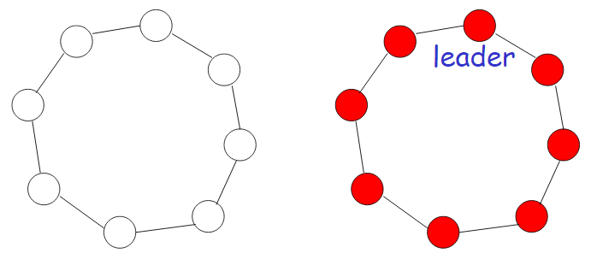
Impossibility Result
Anonymous ring – Processors do not have unique ID’s
Processors identified as left and right neighbours
All processors start in same state
All processors send the same message and receive the same message in every round
Consider ring R of size n > 1 and assume by contradiction that there exists an anonymous algorithm A to elect a leader
For every round k of admissible execution of A in R, the states of all processors at the end of round k is same
Assume lemma holds for k-1
Send message m_{r} to right and m_{l} to left in round k-1 & receive message m_{r} from left and m_{l} from right in round k
All processors receive the same message in round k
Thus if a processors announces itself as a leader at the end of a round, so do all the other processors. Thus it is impossible to elect a leader.
Initial State
Final State

